Slide 1

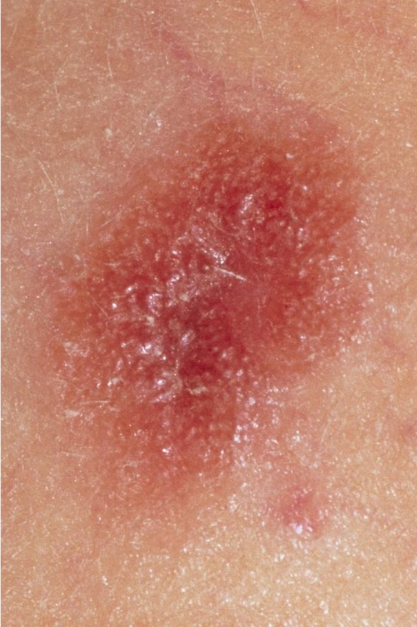
AI Powered Healthcare
Diagnosis
Melanoma is a serious form of skin cancer that requires early detection and treatment. This presentation will explore how deep learning techniques, specifically Convolutional Neural Networks (CNNs), can be leveraged for accurate melanoma diagnosis.
Team Members:
1.Dharineesh NM
2.Kaviarasan M
3.Nithish V

Slide 2
AGENDA:
Problem Statement
Problem Solution
Neural Network
Convolutional Neural Network(CNN)
React Native(Front End)
Backend(Flask)
Conclusion
.

Slide 3
Problem Statement
1
Difficult to Diagnose
2
Subjective Diagnosis
Melanoma is often difficult to diagnose, as it can resemble benign skin lesions.
Traditional diagnosis methods, such as visual inspection by dermatologists, are subjective and prone to errors.
3
Need for Objective Tool
There is a need for a more objective and accurate tool to assist in early melanoma detection.

Slide 4
Problem Solution
Automated Diagnosis
Improved Accuracy
Scalable Solution
Leveraging deep learning techniques, specifically Convolutional Neural Networks (CNNs), to automate the diagnosis of melanoma from images of skin lesions.
CNNs can analyze images more objectively and with higher accuracy than human experts, leading to earlier detection and better patient outcomes.
A CNN-based system can be deployed widely, providing access to accurate melanoma diagnosis for a larger population.

Slide 5
Neural Networks
Pattern Recognition
Complex Relationships
Neural networks are a fundamental machine learning technique that can be trained to recognize patterns in data, such as images of skin lesions.
They are capable of learning complex relationships and making accurate predictions, making them well-suited for medical image analysis.

Slide 6
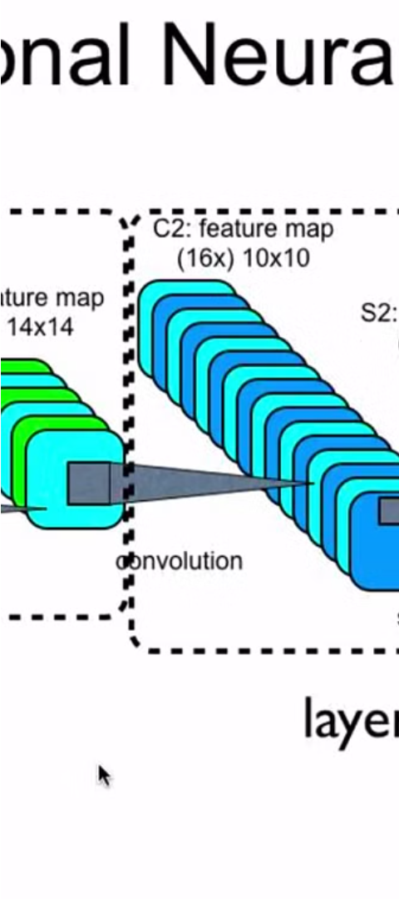
Convolutional Neural Networks (CNNs)
1
Specialized for Images
2
Image Classification
Convolutional Neural Networks (CNNs) are a specialized type of neural network that excel at analyzing visual information.
They are particularly effective for image classification tasks, such as distinguishing between benign and malignant skin lesions.

Slide 7


Transfer Learning by using VGG16 model
Transfer Learning
CNN Architecture
The VGG16 model can be used for transfer learning, leveraging its pre-trained weights to improve the performance of the melanoma detection model.
The VGG16 model's convolutional neural network architecture is well-suited for the task of melanoma image classification.

Slide 8
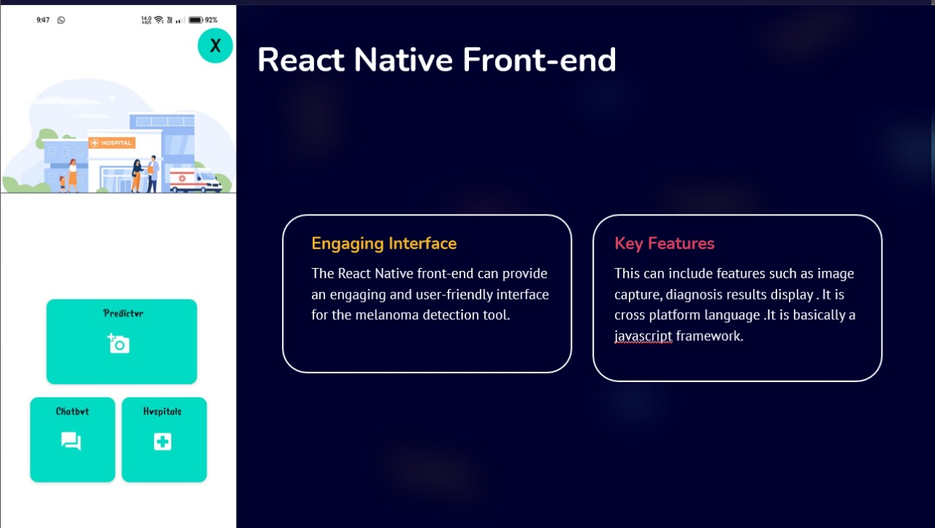

Slide 9
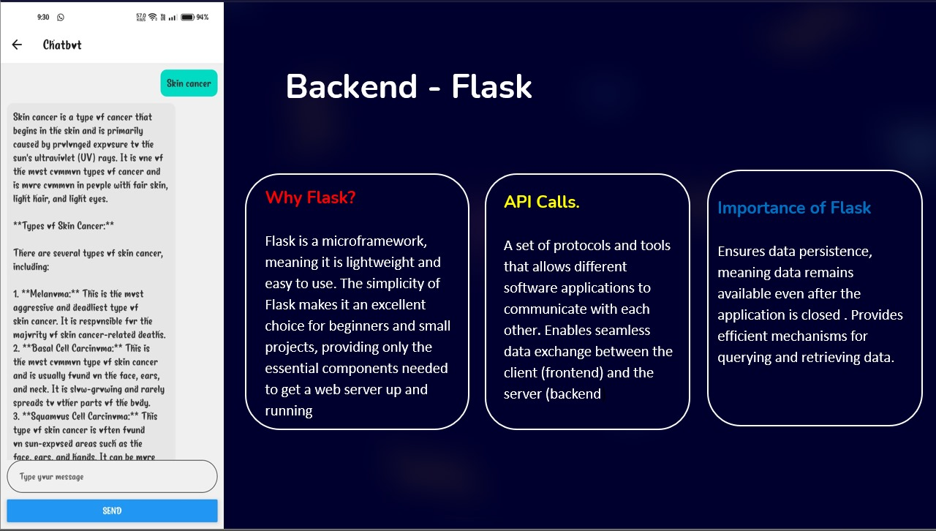

Slide 10
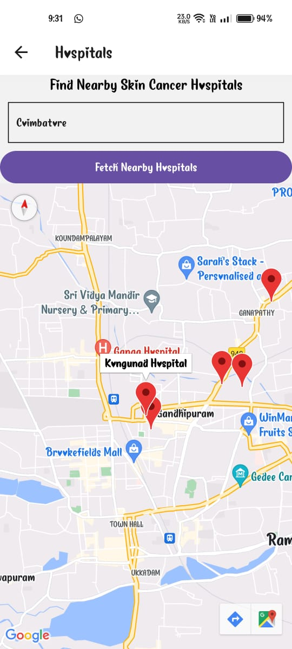



Conclusion and Future Considerations
Improved Melanoma Detection
The integration of CNN-based diagnosis with a React Native front-end can significantly improve the accuracy and accessibility of melanoma detection, leading to earlier treatment and better patient outcomes.
Ongoing Research
Continued research and development in the fields of deep learning and mobile application design can further enhance the capabilities and user experience of the melanoma detection solution.
Broader Applications
The techniques demonstrated in this project can be applied to other medical image analysis tasks, expanding the potential impact of this technology.

Slide 11
References:
https://www.kaggle.com/datasets (For Dataset)
https://keras.io/api/applications (For Model Identification)
https://reactnative.dev (For Frontend)
https://flask.palletsprojects.com/en/3.0.x (For Backend)

